Slide 1
CPU Organization
Unit 2. Processors, Memory and Input/Output
CPU organization
Instruction execution
RISC Vs. CISC
Instruction-level parallelism: pipelining and superscalar architectures
Processor-level parallelism
array computers,
multiprocessors,
multi computers
Microprocessor chips, Architecture of a typical microprocessor
Memory: main memory, secondary memory, types & organization
Input/Output: common types of I/O devices, Controllers

Slide 2
Instruction Execution
Fetch the next instruction from memory into the instruction register.
Change the program counter to point to the following instruction.
Determine the type of instruction just fetched.
If the instruction uses the data in memory, determine where they are.
Fetch the data, if any, into internal CPU registers.
Execute the instruction.
Store the result in the proper place.
Go to step 1 to begin executing next instruction.

Slide 3
A+B
A
Registers
B
A
ALU
B
ALU Input Registers
ALU Output Registers
A+B

Slide 4
Instruction Types
Register to Register: Fetches operands/data from registers and brings information to ALU.
Register to Memory: All memory words are to be fetched into registers
Memory to Memory: Fetches operands/data from registers and brings information to ALU and write backs the results to memory.

Slide 5
RISC Vs. CISC
Reduced Instruction Set Computers
RISC processors only use simple instructions that can be executed within one clock cycle.
Emphasis on software
Simple, faster but many instructions
MIPS, DEC Alpha, SUN Sparc, IBM 801
Complex Instruction Set Computers
Emphasis on completing a task with a few lines of complex instructions
This is achieved by building special processor hardware that is capable of understanding and executing a series of such complex instruction.
Complex and less number of instructions
VAX, Intel X86, IBM 360/370, etc are the examples

Slide 6
Parallel Instruction Execution
SISD: Single Instruction stream, Single Data stream
SIMD: Single Instruction stream, Multiple Data stream
MIMD: Multiple Instruction stream, Multiple Data stream

Slide 7
CPU with many functional Units
Registers
_
+
*
?
+

Slide 8







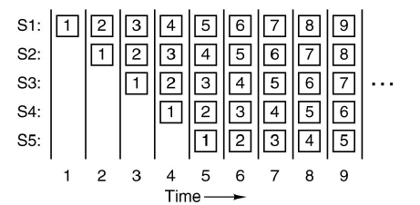




Pipeline Machine
Aata mixing
Backing
Adding Soft drink/Soda
Garnishing
Packing
S1 S2 S3 S4 S5
Instruction fetch unit
Instruction decode unit
Operand fetch unit
Instruction execution unit
Write back unit
Cksinfo.com
Musthavemenus.com
Clipartguide.com
Flickr.com

Slide 9
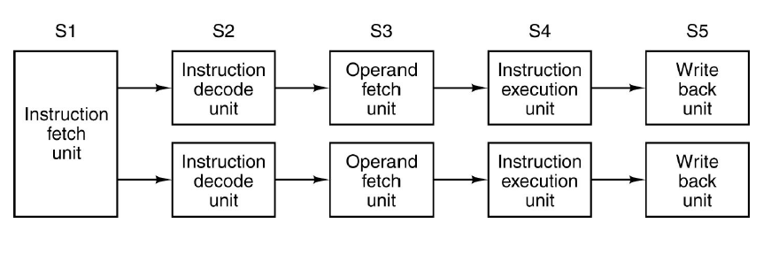
Dual 5 Stage Pipeline Machine

Slide 10
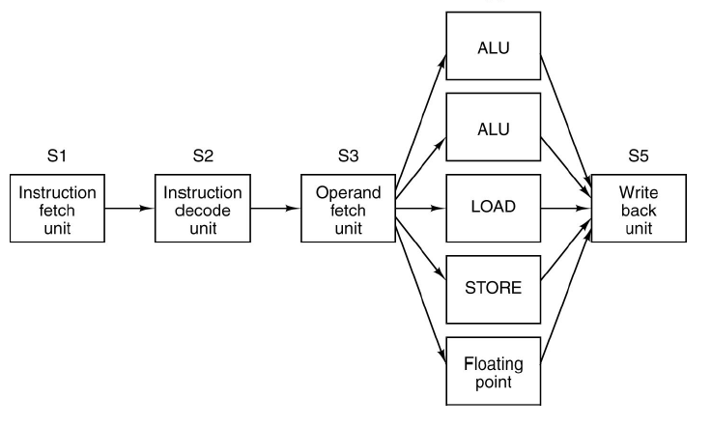
Superscalar Processor with 5 functional Units

Slide 11
A B
Input Vectors
A
B
Vector ALU
A+B
Output Vector
A+B
A+B
A+B

Slide 12
Array Processor illiac IV
Control Unit
Broadcasting Instruction
Processor
Memory
8*8 processor Memory Grid

Slide 13
Multi Computer with Local Memories
Local memory
Local memory
Local memory
CPU
CPU
CPU
Shared Memory
Bus

Slide 14
Memory
The memory is that part of computer where programs and data are stored
Basic unit of memory is the binary digit, called a bit. A bit may contain 0 or 1.
Memory consists of a number of cells/locations, each of which can store a piece of information.
Each cell has a number called address to refer it.
If memory has n cells, the addresses can be 0 to n-1.
If a cell consists of k bits, it can hold any one of 2^{k} different bit combinations.

Slide 15
Three ways of organizing a 96 bit memory
8 bits
12 bits
16 bits
0
1
2
3
4
5
6
7
8
9
10
11
0
1
2
3
4
5
6
7
0
1
2
3
4
5
….
….
….
….
….
….

Slide 16
Byte and words
Byte: A group of 8 bits is called a byte.
1 Kilo byte = 2¹⁰ bytes = 1024 bytes
Bytes are grouped into word, 16 bits word (=2 bytes) and 32 bits (=4 bytes) word.
Most of the instructions operate upon a word, for example adding two words.
Thus a 16 bit machine will have 16 bits registers and 16 bits instructions.

Slide 17
Memory
1 bit = a single digit, either 1 or 0
8 bits = 1 byte, a combination of 1's and 0's
2¹⁰ Bytes = 1024 Bytes = 1 KB (kilobyte)
2²⁰ Bytes = 1024 Kilobytes = 1 MB (megabyte)
2³⁰ Bytes = 1024 Megabytes = 1 GB (gigabyte)

Slide 18

Byte Ordering
0
1
2
3
Address 0 at location 1
Address 1 at location 4
Address 2 at location 8
Address 4 at location 12
3
2
1
0
4
5
6
7
7
6
5
4
8
9
10
11
11
10
9
8
12
13
14
15
15
14
13
12
Big endian Little endian
Byte

Slide 19
J
I
M
3
Address 0 at location 1
Address 1 at location 4
Address 2 at location 8
Address 4 at location 12
3
M
I
J
S
M
I
T
T
I
M
S
8
9
10
11
11
10
9
8
12
13
14
15
15
14
13
12
Big endian Little endian
Byte

Slide 20
Cache Memory
From a French word cacher means hiding…
CPUs have incorporated more and more circuits on a chip. Moreover, superscalar ideas made the CPU much faster.
Memories have also undergone some evolution ; however, the prime consideration was only to increase the capacity in small space.
Slower memory can not utilize the power of an efficient CPU.
The problem can be solved by putting the memories on the chip itself. However, this solution is not economical.
The cache is a smaller, faster memory which stores copies of the data from the most frequently used main memory locations.
When the processor needs to read from or write to a location in main memory, it first checks whether a copy of that data is in the cache. If so, the processor immediately reads from or writes to the cache, which is much faster than reading from or writing to main memory.

Slide 21
Cache Memory
Most modern desktop and server CPUs have at least three independent caches:
an instruction cache to speed up executable instruction fetch,
a data cache to speed up data fetch and store, and
a translation lookaside buffer (TLB) used to speed up virtual-to-physical address translation for both executable instructions and data.
The data cache is usually organized as a hierarchy of more cache levels (L1, L2, etc.; that is Multi-level caches).

Slide 22
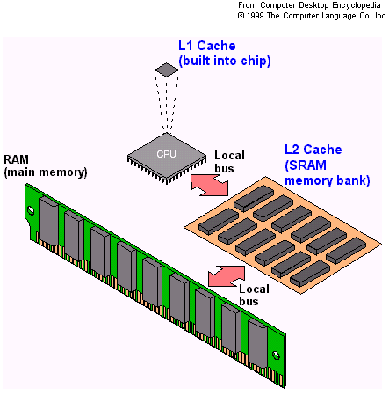
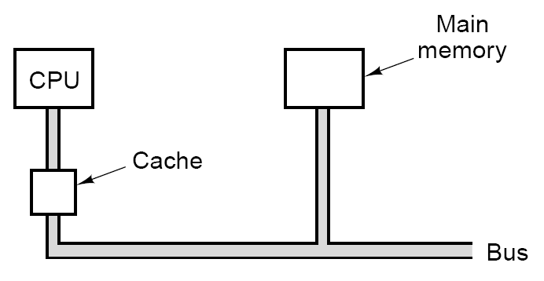
Cache Memory
The data cache is usually organized as a hierarchy of more cache levels (L1, L2, and L3).
http://chipmites.blogspot.in/
L1 and L2 runs at CPU speed, where as L3 runs at slightly slower speed.

Slide 23
Cache Memory: Locality principle
When a word is needed or felt as an important one, it can be brought into the cache memory for faster access.
Along with the word, its neighbors are also brought to the cache.
Using the locality principle, main memory and caches are divided into fixed sized blocks, called cache lines. When a cache miss occurs, or a word is needed to be changed from cache, whole block is reloaded from memory.
To build the cache cache size, cache line, organization, no. of cache, unified /parallel cache, etc parameters are considered.
The trend is split cache for parallel access. (Instructions in one cache and data in another). This is called Harvard architecture.
http://chipmites.blogspot.in/

Slide 24
Microprocessor Chip
The modern CPUs are based on a single chip. This makes the interaction of the CPU with other components of the system well defined.
Each CPU has a set of pins, through which it can communicate to I/O, Co-Processor like Floating point, memory, etc.
Pins
Address pins
Data pins
Control pins → bus control, interrupts, bus arbitration, co-processor signaling, status, etc.

Slide 25
Microprocessor Chip
The pins are connected to other part with similar pins via buses.
CPU communicates by sending and receiving signal via these pins and buses.
A chip with n address pins can address up to 2^{n} memory locations.
Similarly a chip with m data pins can read or write m-bit word in a single operation.
Typical n or m can be 16, 32, 64, ….
That is a CPU with 8 data pins requires 4 operations to read a 32 bit word. CPU with 32 data pins can read the data in a single read operation; however, it is costly.

Slide 26
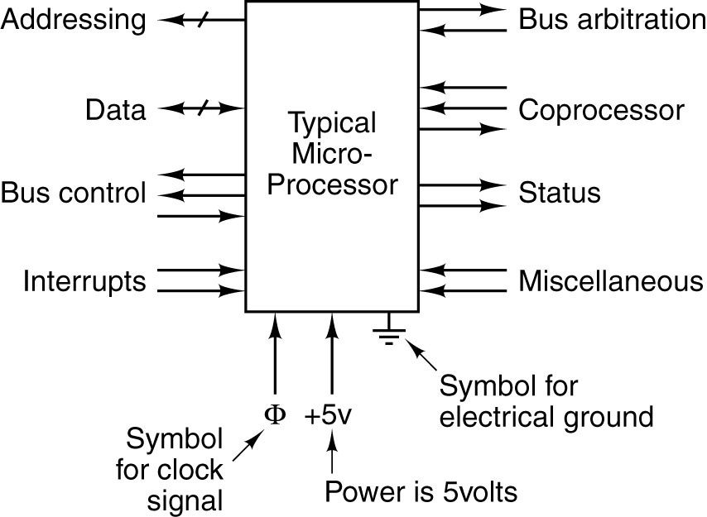
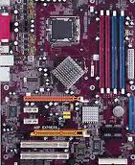
Microprocessor Chip
Bus traffic regulation to avoid use of same resources such as I/O
Interaction with co-processors such as floating point.
Mostly from CPU to Bus
CPU status information
I/O devices to CPU, CPU initiates I/O, and goes off to do some other work…

Slide 27
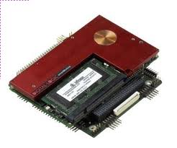
Pentium Processors
Intel introduced microprocessors in 1969
4-bit microprocessor 4004
8-bit microprocessors
8080
8085
16 and more bits processors
8086 introduced in 1979 with 20-bit address bus and 16-bit data bus
Can address up to 4 segments of 64 KB (16*4)
Referred to as the real mode
8088 is a less expensive version as it uses 8-bit data bus but address bus 20 bits.
80186, 80286 (1982), 80386(1985), 80486(1989), 80586(1993, 64 data bus), Pentium Pro(1995), Pentium II(1997), Itanium (RISC, 64 bit processor and 128 bit data bus) ), and atom (low power 32 bit microprocessor.

Slide 28
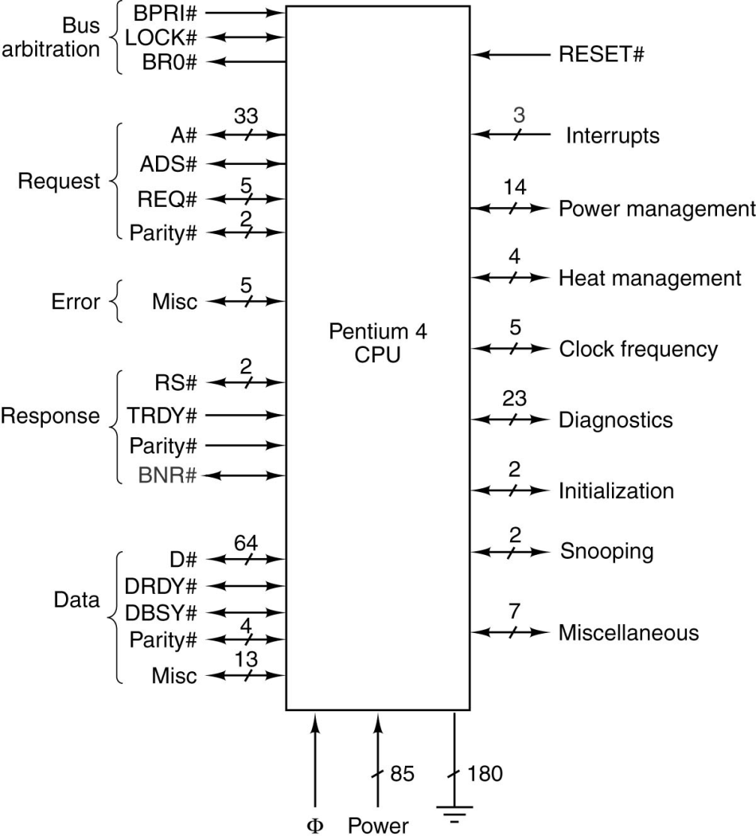
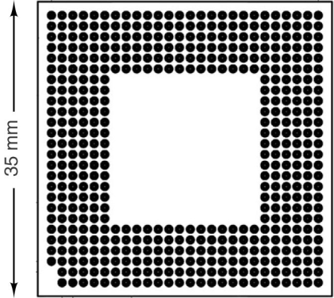
Pentium IV logical and physical Pinout

Slide 29
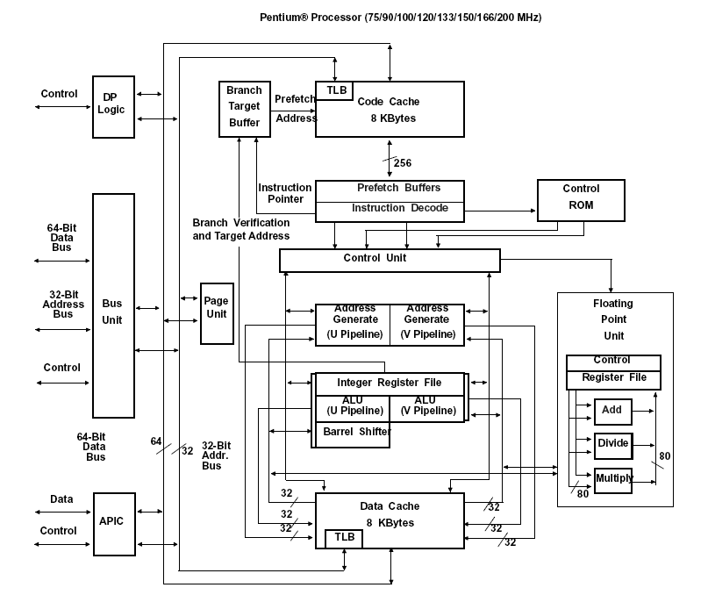
www.intel.com
Pentium processor

Slide 30
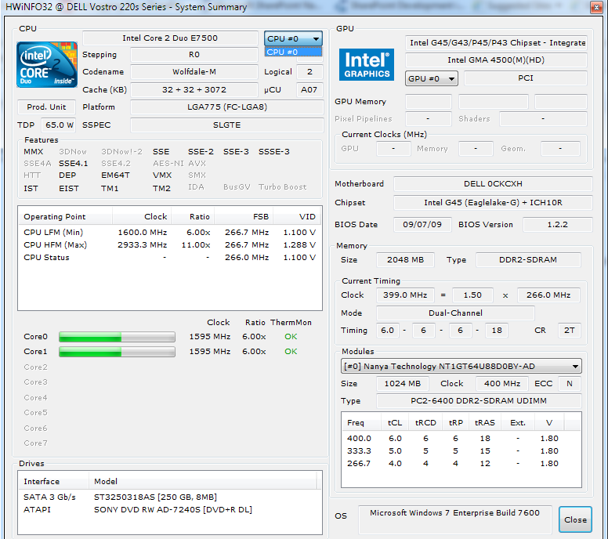

Slide 31
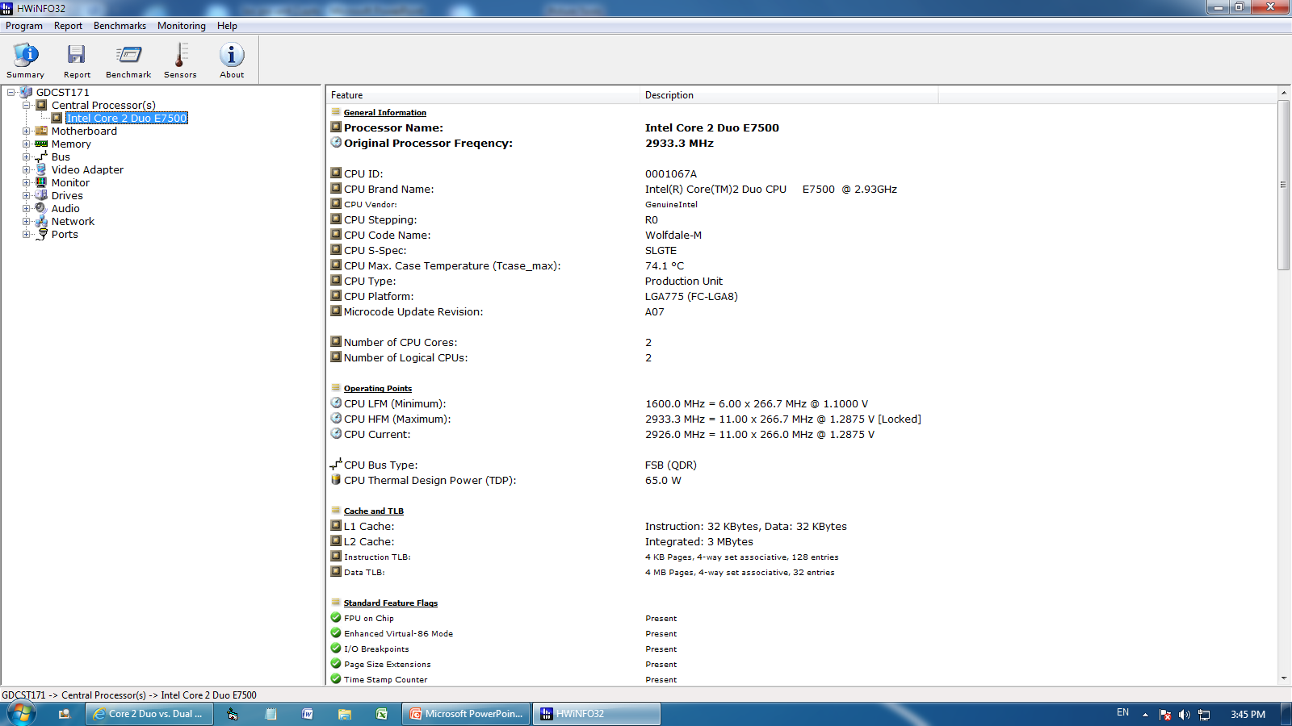

Slide 32
Computer Memories
Registers
Cache
Main memory
Magnetic disk
Tape and optical disk

Slide 33
Primary Memory
Primary memory, also known as main memory, is an important part of a computer in which data is stored for quick access by the computer's processor.
It is made of larger number of cells. Each cell is identified by a number called an address of the cell.
Each cell contains a piece of data. When there is a requirement of the data, the cell address is used to retrieve the data.
The primary memory is organized in such a fashion that the time required to store or retrieve data from a cell is independent of the cell addresses. That is any location of the memory can be chosen randomly for use. This is known as Random Access Memory (RAM).
There are other access methods which are not random. For example sequential access, First In First Out (FIFO) access and Last In First Out access (LIFO) .

Slide 34
Primary Memory
In sequential access memory, data is stored serially or sequentially in a long string. When you want to access some part of the string, you have to pass through the previous part of the string.
Just like in an audio tape, if you want to hear the third song, first two songs must be fast forwarded.
FIFO is just like queue, where first entry will be served first and last will be entertained at last. LIFO is like tray (or pile) of papers. The paper which you had put at last, will come out first.

Slide 35
FIFO and LIFO
IN
System Processes
OUT
First In First Out (FIFO)
IN
System Processes
OUT
Last In First Out (FIFO)

Slide 36
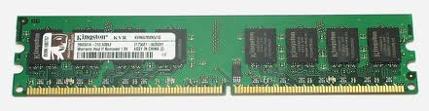
Primary Memory: RAM
RAM is a volatile memory.
The content written in RAM requires continuous power supply to retain it into the memory.
There are two basic types of the RAM. The first one is static and second is dynamic. Dynamic RAM (DRAM) needs to be refreshed thousands of times per second. Static RAM (SRAM) does not need to be refreshed, which makes it faster; but it is more expensive than dynamic RAM.
Both types of RAM are volatile, meaning that they lose their contents when the power is turned off.

Slide 37
Primary Memory: ROM
Computers also contain Read Only Memory (ROM) which are used to permanently record data and instructions.
Content of ROM can only be read.
Unlike RAM, ROM retains its content even when the computer is turned off.
ROM is an ideal memory to store critical instructions into the computers such as boot programs (programs that start ups the computer system), printer driver files, and fonts etc.
A variation of a ROM is a Programmable Read Only Memory (PROM). PROMs are manufactured as blank chips on which data can be written with a special device called a PROM programmer.

Slide 38


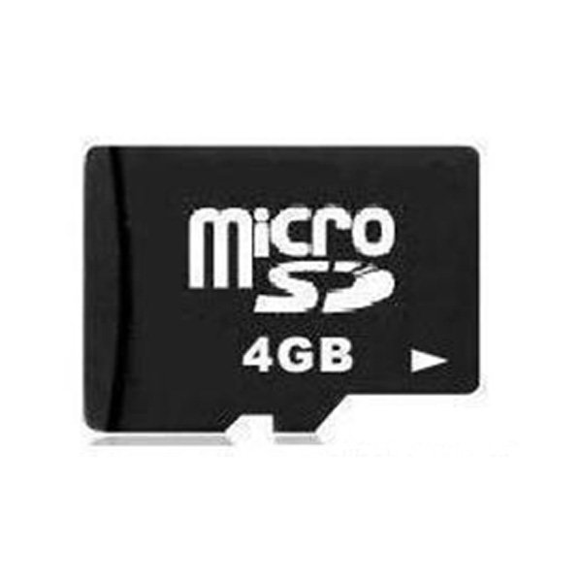
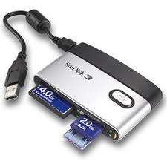
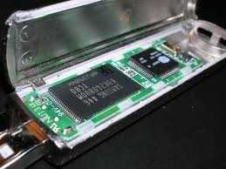
Primary Memory: ROM
There is a special type of PROM called Erasable PROM (EPROM).
An EPROM allows the content of PROM erased by exposing it to ultraviolet light.
Instead of ultraviolet lights, electric signals are used to erase content of PROM. Such memory is called Electrically Erasable PROM (EEPROM).
EEPROMS are very useful in manufacturing USB pen drives, cellular phones (memory card in mobile phone), digital cameras, portable MP3 players and microSD cards.
Mobile phone
Pen drive
4 GB memory card
memory card reader

Slide 39
RAM | ROM
RAM is random access memory. | ROM stands for Read only memory.
RAM supports reading and writing operations into the computer. | ROM is read only memory.
Data and instructions are stored into it during its operation. | Instructions are stored into it during its manufacturing.
It is volatile memory. | It is non-volatile memory.

Slide 40
Secondary Memory
Computer Memory
Primary Memory
Secondary Memory
RAM
ROM
Hard Disk
CD ROM
Pen Drives
Memory Card
…
SRAM
DAM
PROM
EPROM
EEPROM

